Slide 1
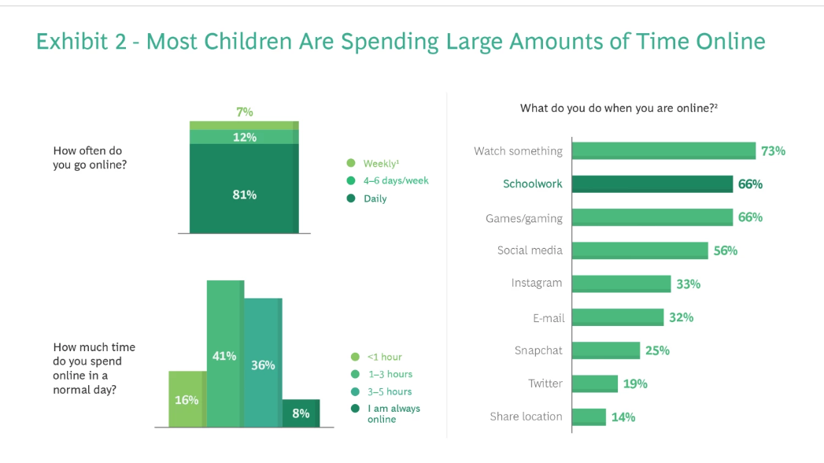
AMOUNT OF TIME CHILDREN SPEND ONLINE
https://www.bcg.com/publications/2022/why-children-are-unsafe-in-cyberspace

Slide 2
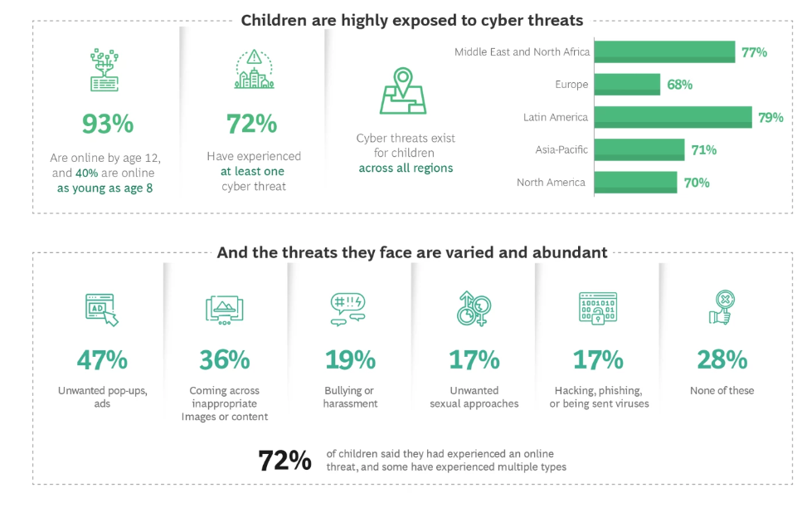
https://www.bcg.com/publications/2022/why-children-are-unsafe-in-cyberspace

Slide 3
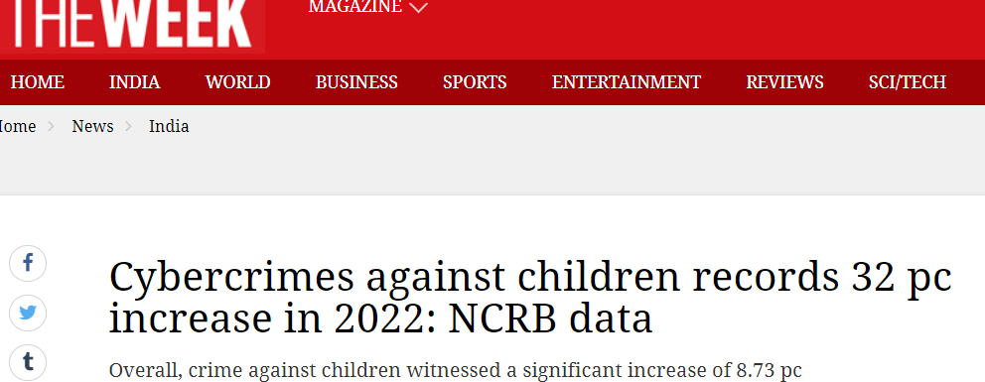

Slide 4
TYPES OF Cyber Crimes
Identity Theft, Catfishing
Cyber Bullying ,Cyber Stalking
Phishing, Vishing, Smishing
Cyber Grooming
Trolling
Doxing , Excluding
Misuse of Deepfake Technology
Sextortion, Child Pornography, Sexting
E Commerce Frauds

Slide 5
Student ECOSYSTEM
Parents
Schools and Education System
Tech and Gaming Companies
Law Enforcement and Judicial System
Children

Slide 6
“If its known, its manageable. If its well-known, its actionable.”
Notes:
Strong cyber security measures are now essential due to society’s growing reliance on technology. India, one of the digital economies with the highest rate of growth in the world, understands the importance of safeguarding its online presence. The cyber safety laws and framework have evolved with time with the newest measures put up in 2023. New laws were put in place in 2024 to improve the nation’s foundation for cyber security.

Slide 7
Cyber Security and Safety Framework in India
Cyber Laws in India
Information Technology Act 2000
Digital Personal Data Protection Act 2023
Other Relevant Regulations
Key Provisions
Data Privacy Regulations
Cybercrime Definitions
Punishments and Penalties
Enforcement Mechanisms
Cyber Cells and Police Stations
National Cyber Crime Reporting Portal
Legal Procedures and Courts
Impact on Cybersecurity
Safeguarding Digital Assets
Promoting Data Privacy
Enhancing Cyber Defence Capabilities
Notes:
There are four pillars of ……..
Information Technology Act 2000 (IT Act): This law provides the legal framework for regulating various aspects of cyberspace and addressing cybercrimes.
- Digital Personal Data Protection Act 2023 (DPDP Act): This Act aims to protect individuals' rights regarding their personal data and regulates its processing by organizations.
- Other Relevant Regulations: This could include any supplementary laws, regulations, or amendments related to cybersecurity and data protection.
2. Key Provisions:
- Data Privacy Regulations: Provisions related to the collection, storage, processing, and sharing of personal data by organizations.
- Cybercrime Definitions: Definitions of various cybercrimes such as hacking, identity theft, online fraud, etc., along with their legal implications.
- Punishments and Penalties: Details about the penalties and punishments prescribed for different cyber offenses under the IT Act and other relevant laws.
3. Enforcement Mechanisms:
- Cyber Cells and Police Stations: Specialized units within law enforcement agencies dedicated to investigating cybercrimes.
- National Cyber Crime Reporting Portal: An online platform for reporting cybercrimes and seeking assistance from law enforcement authorities.
- Legal Procedures and Courts: Explanation of the legal procedures involved in investigating and prosecuting cybercrimes, including the role of courts and judicial processes.
4. Impact on Cybersecurity:
- Safeguarding Digital Assets: The role of cyber laws in protecting sensitive digital information and intellectual property.
- Promoting Data Privacy: How legal provisions contribute to ensuring the privacy and confidentiality of personal and organizational data.
- Enhancing Cyber Defense Capabilities: The overall impact of cyber laws on strengthening cybersecurity measures and mitigating cyber threats and attacks.

Slide 8
Some Important Government Initiatives
Formation of CERT-In in 2004
National Cyber Security Policy, 2013,
Cyber Swachhta Kendra (Botnet Cleaning and Malware Analysis Centre) in 2017
Data Protection and Privacy Regulations in 2017
National Critical Information Infrastructure Protection Centre (NCIIPC)
Cybersecurity Cooperation and International Engagements

Slide 9
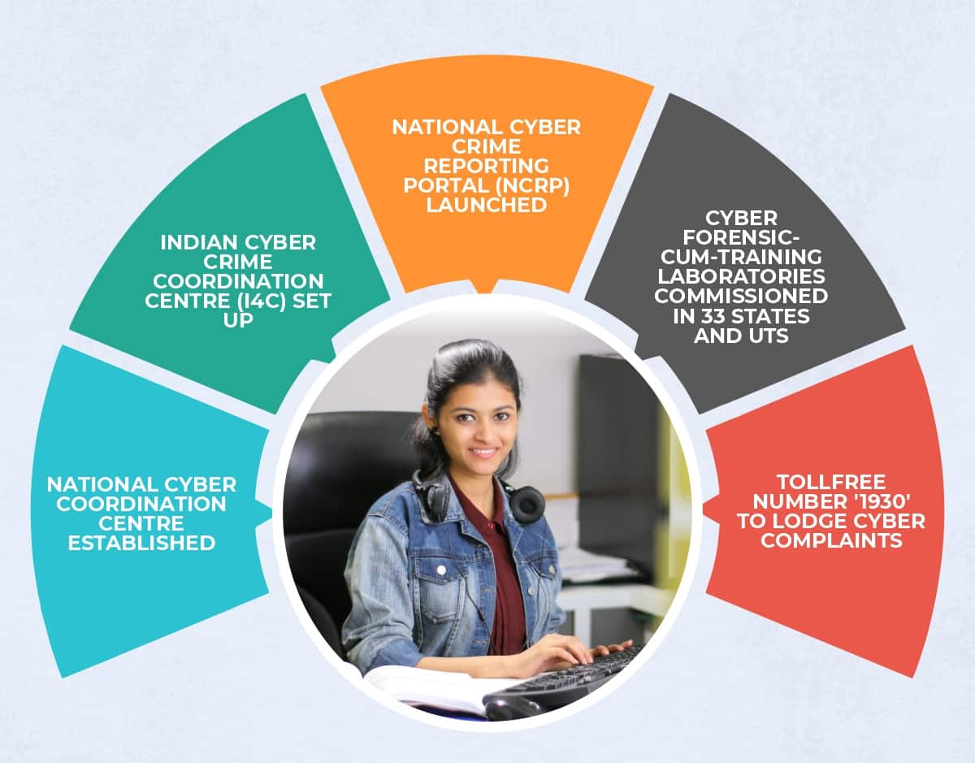

Slide 10
Cyber Clubs
To create awareness among students and teachers about:
Cyber Crimes
Legal Provisions
Reporting Mechanisms
To promote sharing of experiences/information about cyber crimes

Slide 11
Activity Know the Crime
Individual Activity
The teacher makes chits with names of various cyber crimes covered in the content.
Each student picks up one chit and cites any one incident related to that particular cyber crime.
Incident may be:
Real / imaginary
From a book/movie/newspaper
Heard from friends/parents/teachers/relatives
May not reveal names / places
Audience (Other Students) will give suggestions on what should be done
https://www.healthspectra.com/wp-content/uploads/2019/05/Share-your-experiences.jpg

Slide 12
Activity How Smart Are You?
Group Activity
The class is divided into two teams - A and B.
One member of team A is secretly given the name of the cyber crime.
He /she enacts the given word and team A guesses the name of the crime.
The student may enact any incident or clues that may hint at that particular cyber crime.
https://www.gamesver.com/wp-content/uploads/2020/02/Illustration-of-Kids-Playing-Charades.jpg

Slide 13
The IT Act
The IT Act is the primary legislation governing various cyber activities and offenses in India.
It defines offenses such as hacking, data theft, identity theft, and cyberterrorism and prescribes penalties for offenders.
Additionally, it provides legal recognition for electronic documents, digital signatures, and electronic governance.

Slide 14
Scenario 1
Jatin is a young professional who loves to play online games with his friends and colleagues. In order to discourage his opponents and make them nervous , he sends messages undermining their playing prowess and at times he also uses abusive and offensive words.

Slide 15
Section 66-A
Addresses the transmission of offensive messages through digital devices, aiming to curb cyberbullying and harassment, especially among children
Offenders can face imprisonment for up to three years and fines.
This Photo by Unknown Author is licensed under CC BY-SA

Slide 16
Scenario ii
A shopkeeper sexually exploited a child and filmed the act. He then sold the same on the dark web and also shared with his friends.

Slide 17
Section 67-B
Offenders can face imprisonment for up to Seven years and fines or both
Imposes penalties for publishing or transmitting material depicting children in sexually explicit acts online, safeguarding minors from exploitation.
Exploitation

Slide 18
Scenario 3
Sarah, receives an email from her company's IT department, instructing her to update her software. She clicks on the provided link, unknowingly downloading ransomware onto her computer that encrypt/damage her data

Slide 19
Section 43
Penalizes downloading data that leads to malware or ransomware attacks, emphasizing the importance of cybersecurity measures to protect children from online threats.
Offenders can face penalties of up to one crore rupees.
Online Threats
This Photo by Unknown Author is licensed under CC BY-NC-ND

Slide 20
List of provisions for punishment of cyber crimes in India

Slide 21
IT Act Offence List
Activity :
Let’s Play Stapoo
Section | Offence
43 | Downloading the data which leads to virus, ransomware, or DOS Attack.
65 | Tampering with Computer Source Documents
66 | Computer Related Offences
66-A | Sending offensive messages through Communication service, etc...
66-B | Dishonestly receiving stolen computer resource or communication device
66-C | Identity Theft
66-D | Cheating by impersonation by using computer resource
66-E | Violation of Privacy
67 | Publishing or transmitting obscene material in electronic form
67-A | Publishing or transmitting of material containing sexually explicit act, etc... in electronic form
67-B | Publishing or transmitting of material depicting children in sexually explicit act etc., in electronic form

Slide 22
43 | 67
66 - E
66 – C | 66 - D
66 -B
66 | 66 - A
65
Cheating by impersonation by using computer resource
Notes:
Requirements: Space to draw the maze on the floor, chalk, a flat piece of stone (stapoo)
Tips on IT Act to be given to students (Worksheet No -3)
Create the maze given in the worksheet using chalk on the floor. The maze should be big enough so that students can jump and stand over it. The numbers given in each box should be clearly written.
Each student upon their turn will throw the flat stone(stapoo) on the maze. In whichever box the stone falls, the student will speak about the section number of IT Act mentioned in the box. The students may refer to the instruction card that is given before this activity.
The teacher will give 5 points each for speaking the correct offence and 5 points for the example.

Slide 23
Activity : Who’s the Lawyer?
The class will be divided into three teams.
One team will send a representative as victim, second as offender, and third as lawyer. The team will be positioned with their placards.
The teacher will then announce a hypothetical situation representing a Cyber offense. Based on the situation, the victim, accused, and lawyer will play their part.
Lawyer
Victim
Offender
This Photo by Unknown Author is licensed under CC BY-NC-ND

Slide 24
Children’s Online Privacy Protection Rule
Websites or online services, collecting personal information of children below the age of 13 years, must obtain parental consent before doing so.

Slide 25
Digital Personal Data Protection (DPDP ) Act 2023
to protect the rights of individuals to protect their personal data
If that data is collected it has to be used for lawful purposes only.
Implement technical and organisational measures to safeguard personal data of their clients/customers.
A proper agreement should be signed between the organisation and the individual(s) whose data is being collected.
Irrecoverably delete personal data after the purpose for which it was collected has expired.
Notify personal data breaches to the Data Protection Board and affected individuals.

Slide 26
Activity Cyber Cross
Individual Activity
Solve the crossword based on clues on cyber crimes and legal provisions

Slide 27
Cyber Security Tips for Students
1
Be respectful to other online users.
Do not open suspicious emails and/or take suspicious phone calls.
Use strong passwords.
Do not click on ad pop-ups or on any suspicious links.
Never leave your devices unattended, especially if you are logged in to any application
Always use original and updated software and antivirus
Browse secure websites
2
3
4
5
6
7

Slide 28
Cyber Security Tips for Students
8
Back up your data on a regular basis.
Always opt for Two -Factor Authentication.
Download software from authenticated websites/play stores
Do not perform any sort of financial transactions on any public network.
Never share your personal and confidential information such as usernames, passwords, OTP, CVV, etc. with anyone.
Check your privacy settings on regular basis
Do not make friends with strangers online
9
10
11
12
13
14

Slide 29
Activity nukkad natak

Slide 30
Activity nukkad natak
The class will be divided into groups of 5 students.
Each team will be allocated one cyber safety threat by the teacher at least one week before the activity.
Students will research and identify tips to prevent/overcome the cyber safety threat
They will then design a script around the concept and prepare a Nukkad Natak
On the day of activity, each team will perform.
The teacher may select the team with the best performance to present in the morning assembly.

Slide 31
Steps to be taken by school in case of cyber crime is reported
Take the child into confidence
Inform the parents of the victim.
The Principal should form a committee
Refer the child to school counsellor
Collect evidence from social media
Take advice from a cyber law expert.
Notes:
and comfort him/her, so that he/she can report the matter with precise details. The identity of the victim and the student who is reporting should be kept secret.
If the matter is of grave concern, report the matter to the nearest police station or register a complaint on www.cybercrime.gov.in

Slide 32
Preventive steps
Keep a complaint box
Introduce e-clubs for cyber awareness,
Conduct regular workshops for students, parents, teachers, administrative, and support staff of the school.

Slide 33
Activity Rally For All
https://creazilla-store.fra1.digitaloceanspaces.com/cliparts/1324652/protest-clipart-md.png

Slide 34
Activity Rally For All
All the members of the cyber club will create a placard depicting one do or one don’t in cyberspace.
After the placards are ready the teacher will allocate 4 members per class or as per number of students in a school.
The selected members will go to the allocated classroom and hold the placards above their shoulders.
The members will also speak about one example justifying the do or don’t.
The same activity can also be conducted outside the school premises to spread awareness among the people of the community.

Slide 35
Reporting Mechanisms
In case of financial fraud, approach the bank immediately
To file a report:
Approach the nearest cyber police station to report the crime.
Call the universal helpline number to report cyber crime in India:
1930

Slide 36
Reporting Mechanisms
Register a complaint on the National Cyber Crime Reporting Portal
(www.cybercrime.gov.in).

Slide 37
Activity How to Report?
Each student will make a poster on any reporting mechanism covered in the content.
The posters will be pinned up on school display boards during cyber awareness week.
They can use these posters for the Rally For All activity

Slide 38
MANTRA FOR ONLINE SECURITY
(3PRS)
Precaution
Prevention
Protection
Reporting
Sharing

